Slide 1

Andrés Viloria
September 10,2023
https://github.com/andresvdata

Slide 2

Outline
Executive Summary
Introduction
Methodology
Results
Conclusion
Appendix

Slide 3
Executive Summary
I collected data from the public SpaceX API and the SpaceX Wikipedia page. Then, I added a column called 'class' to classify successful landings. To analyze the data, I used SQL, visualizations, folium maps, and dashboards. I selected the relevant columns as features for further analysis.
Next, I converted all the categorical variables into binary using a technique called one hot encoding. I standardized the data and used GridSearchCV to find the best parameters for the machine learning models. Finally, I visualized the accuracy scores of all the models.
I created four machine learning models: Logistic Regression, Support Vector Machine, Decision Tree Classifier, and K Nearest Neighbors. Surprisingly, all the models produced similar results, with an accuracy rate of around 83.33%. However, it's important to note that all the models tended to over-predict successful landings.
To improve the model's accuracy and make more accurate predictions, we need to gather more data.

Slide 4
Introduction
Background
Commercial travels to Space is being more affordable.
Space X has best pricing ($62 million vs. $165 million USD)
The reason space travel is so expensive is because the materials used are not reusable. Space Y aims to compete with Space X by finding ways to make space travel more affordable through reusing the stage 1.
Problem
Space Y aims to develop the capability to predict whether or not the first stage of a rocket can be successfully recovered.

Slide 5

Section 1

Slide 6
Methodology
Executive Summary
Data collection methodology:
Data was collected from two sources : SpaceX public API and Wikipedia.
Perform data wrangling
Data wrangling by landing success.
Perform exploratory data analysis (EDA) using visualization and SQL
Perform interactive visual analytics using Folium and Plotly Dash
Perform predictive analysis using classification models
The object of model was created, then the hyperparameters were evaluated and selected based on r2 score and result was compared to other ML models.

Slide 7
Data Collection
To gather the data, I used a combination of two methods. First, I made requests to Space X's public API to get some information. Second, I scraped data from a table on Space X's Wikipedia page.
In the API data, we have different categories such as Flight Number, Date, Booster Version, Payload Mass, Orbit, Launch Site, Outcome, Flights, GridFins, Reused, Legs, Landing Pad, Block, Reused Count, Serial, Longitude, and Latitude.
The Wikipedia data that we gathered through web scraping includes Flight Number, Launch Site, Payload, Payload Mass, Orbit, Customer, Launch Outcome, Booster Version, Booster Landing, Date, and Time.
In the next slide, you will see a flowchart that explains how we collected data from the API, and in the slide after that, you will see a flowchart showing how we collected data through web scraping.

Slide 8
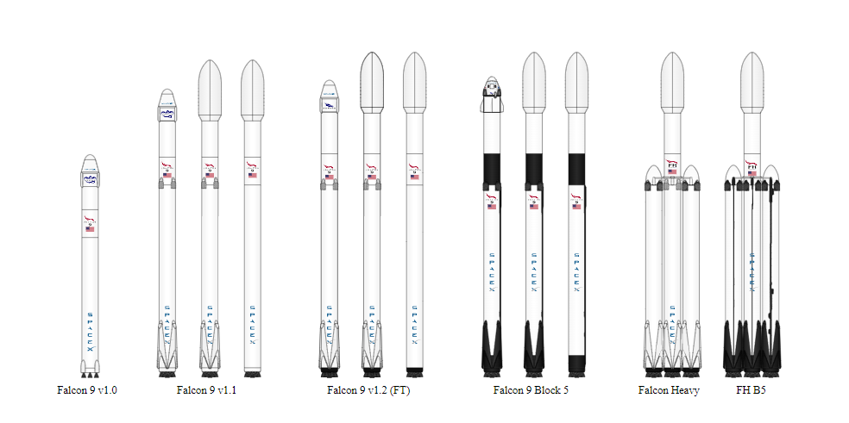
Data Collection – SpaceX API
Data collection -API
GitHub URL
Extract data from Space X API > Json file
From the Json extracted was transformed into Dataframe
Relevant Dictionary was extracted from the previous dataframe
The important keys and information was selected and saved into another df
Data quality was checked by replacing the missing values with the mean.

Slide 9
Data Collection - Scraping
GitHub URL
Request website Wikipedia by using Beautiful Soup.
Find the proper html table to get the data needed.
Create dict with all values needed form the target table
Cast the dictionary to dataframe

Slide 10
Data Wrangling
To create a training label indicating the landing outcomes, I assigned a value of 1 for successful landings and 0 for failures. The outcome column consists of two components: "Mission Outcome" and "Landing Location".
I created a new training label column called "class". If the "Mission Outcome" is True, I set the value in the "class" column to 1. For the specific landing locations, I map the following values:
If the "Landing Location" is True for ASDS (Autonomous Spaceport Drone Ship), RTLS (Return to Launch Site), or Ocean, we will set the "class" value to 1.
If the "Landing Location" is None for both components or if "Mission Outcome" is False for ASDS, None for ASDS, False for Ocean, or False for RTLS, I set the "class" value to 0.
EDA of orbits
Calculate the number and occurrence of each orbit
Calculate the number and occurrence of mission outcome per orbit type
Create a landing outcome label from Outcome column
GitHub URL

Slide 11
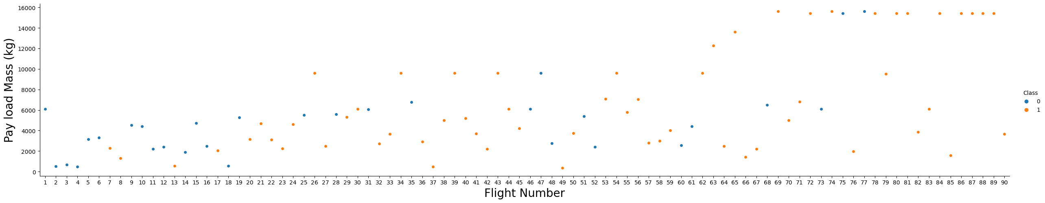
EDA with Data Visualization
FlightNumber vs. PayloadMass
Catplot was used to see the changes of pay loads per flight number. Both variables are numeric. Catplot make easier to see all the values of x axis vs y axis if we compare with scatterplot.
GitHub URL

Slide 12
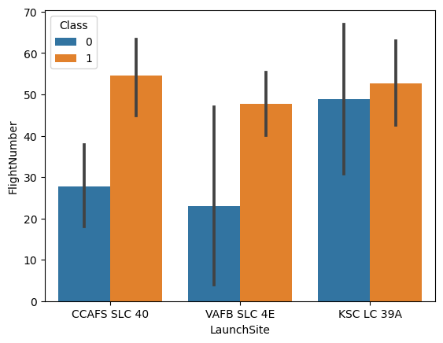
EDA with Data Visualization
Visualize the relationship between Flight Number and Launch Site
Barplot was used to see to plot one numerical and categorical variable.
GitHub URL

Slide 13
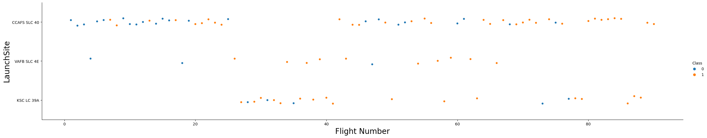
EDA with Data Visualization
Visualize Flight Number and the launch site.
Catplot was used to visualize the where the flight was launched over the time( flight number).
GitHub URL

Slide 14
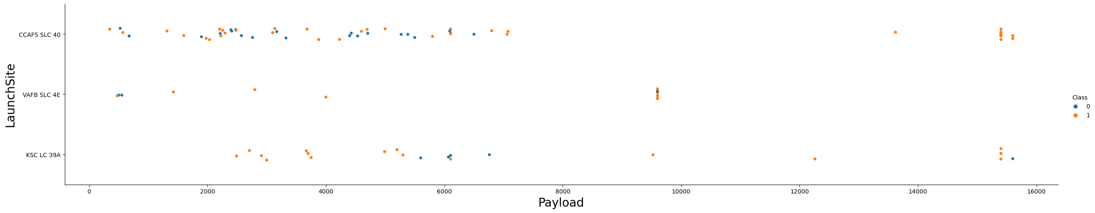
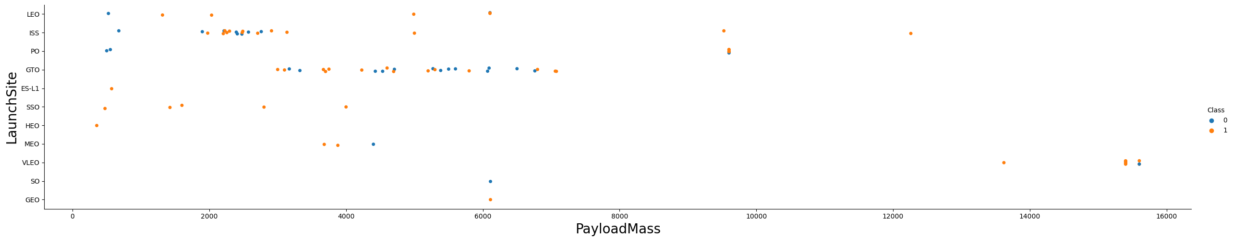
EDA with Data Visualization
Visualize the relationship between Payload , PayloadMass and Launch Site
Catplot was used to verify if the payload change with the launch site.
GitHub URL

Slide 15
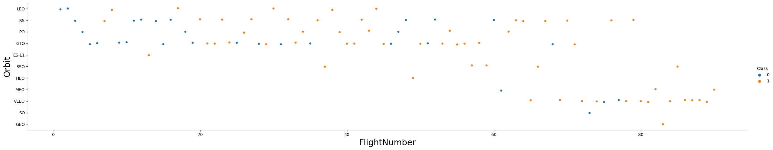
EDA with Data Visualization
Orbit vs flight number
Catplot was used to verify the orbit changes over the time (flight number)
GitHub URL

Slide 16
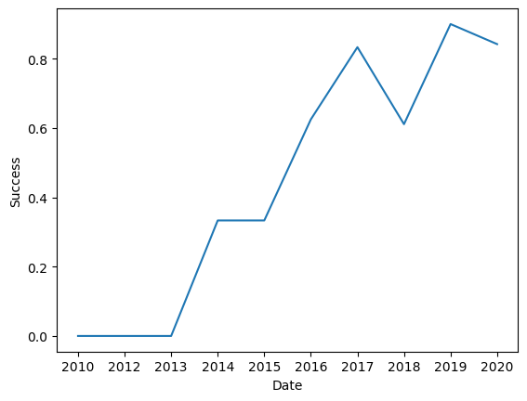
EDA with Data Visualization
Success over the time
Lineplot is used to show trends.
GitHub URL

Slide 17
EDA with SQL
Display the names of the unique launch sites in the space mission
Display 5 records where launch sites begin with the string 'CCA’
Display the total payload mass carried by boosters launched by NASA (CRS)
Display average payload mass carried by booster version F9 v1.1
List the date when the first succesful landing outcome in ground pad was acheived.
List the names of the boosters which have success in drone ship and have payload mass greater than 4000 but less than 6000
List the total number of successful and failure mission outcomes
List the names of the booster_versions which have carried the maximum payload mass. Use a subquery
List the records which will display the month names, failure landing_outcomes in drone ship ,booster versions, launch_site for the months in year 2015.
Rank the count of landing outcomes (such as Failure (drone ship) or Success (ground pad)) between the date 2010-06-04 and 2017-03-20, in descending order.
GitHub URL

Slide 18
Build an Interactive Map with Folium
Summarize what map objects such as markers, circles, lines, etc. you created and added to a folium map
Explain why you added those objects
Add the GitHub URL of your completed interactive map with Folium map, as an external reference and peer-review purpose
GitHub URL

Slide 19
Build a Dashboard with Plotly Dash
Summarize what plots/graphs and interactions you have added to a dashboard
Explain why you added those plots and interactions
Add the GitHub URL of your completed Plotly Dash lab, as an external reference and peer-review purpose

Slide 20
Predictive Analysis (Classification)
Summarize how you built, evaluated, improved, and found the best performing classification model
You need present your model development process using key phrases and flowchart
Add the GitHub URL of your completed predictive analysis lab, as an external reference and peer-review purpose

Slide 21
Results
Exploratory data analysis results
Interactive analytics demo in screenshots
Predictive analysis results

Slide 22

Section 2

Slide 23
Flight Number vs. Launch Site
Show a scatter plot of Flight Number vs. Launch Site
Show the screenshot of the scatter plot with explanations

Slide 24
Payload vs. Launch Site
Show a scatter plot of Payload vs. Launch Site
Show the screenshot of the scatter plot with explanations

Slide 25
Success Rate vs. Orbit Type
Show a bar chart for the success rate of each orbit type
Show the screenshot of the scatter plot with explanations

Slide 26
Flight Number vs. Orbit Type
Show a scatter point of Flight number vs. Orbit type
Show the screenshot of the scatter plot with explanations

Slide 27
Payload vs. Orbit Type
Show a scatter point of payload vs. orbit type
Show the screenshot of the scatter plot with explanations

Slide 28
Launch Success Yearly Trend
Show a line chart of yearly average success rate
Show the screenshot of the scatter plot with explanations

Slide 29
All Launch Site Names
Find the names of the unique launch sites
Present your query result with a short explanation here

Slide 30
Launch Site Names Begin with 'CCA'
Find 5 records where launch sites begin with `CCA`
Present your query result with a short explanation here

Slide 31
Total Payload Mass
Calculate the total payload carried by boosters from NASA
Present your query result with a short explanation here

Slide 32
Average Payload Mass by F9 v1.1
Calculate the average payload mass carried by booster version F9 v1.1
Present your query result with a short explanation here

Slide 33
First Successful Ground Landing Date
Find the dates of the first successful landing outcome on ground pad
Present your query result with a short explanation here

Slide 34
Successful Drone Ship Landing with Payload between 4000 and 6000
List the names of boosters which have successfully landed on drone ship and had payload mass greater than 4000 but less than 6000
Present your query result with a short explanation here

Slide 35
Total Number of Successful and Failure Mission Outcomes
Calculate the total number of successful and failure mission outcomes
Present your query result with a short explanation here

Slide 36
Boosters Carried Maximum Payload
List the names of the booster which have carried the maximum payload mass
Present your query result with a short explanation here

Slide 37
2015 Launch Records
List the failed landing_outcomes in drone ship, their booster versions, and launch site names for in year 2015
Present your query result with a short explanation here

Slide 38
Rank Landing Outcomes Between 2010-06-04 and 2017-03-20
Rank the count of landing outcomes (such as Failure (drone ship) or Success (ground pad)) between the date 2010-06-04 and 2017-03-20, in descending order
Present your query result with a short explanation here

Slide 39

Section 3

Slide 40
<Folium Map Screenshot 1>
Replace <Folium map screenshot 1> title with an appropriate title
Explore the generated folium map and make a proper screenshot to include all launch sites’ location markers on a global map
Explain the important elements and findings on the screenshot

Slide 41
<Folium Map Screenshot 2>
Replace <Folium map screenshot 2> title with an appropriate title
Explore the folium map and make a proper screenshot to show the color-labeled launch outcomes on the map
Explain the important elements and findings on the screenshot

Slide 42
<Folium Map Screenshot 3>
Replace <Folium map screenshot 3> title with an appropriate title
Explore the generated folium map and show the screenshot of a selected launch site to its proximities such as railway, highway, coastline, with distance calculated and displayed
Explain the important elements and findings on the screenshot

Slide 43

Section 4

Slide 44
<Dashboard Screenshot 1>
Replace <Dashboard screenshot 1> title with an appropriate title
Show the screenshot of launch success count for all sites, in a piechart
Explain the important elements and findings on the screenshot

Slide 45
<Dashboard Screenshot 2>
Replace <Dashboard screenshot 2> title with an appropriate title
Show the screenshot of the piechart for the launch site with highest launch success ratio
Explain the important elements and findings on the screenshot

Slide 46
<Dashboard Screenshot 3>
Replace <Dashboard screenshot 3> title with an appropriate title
Show screenshots of Payload vs. Launch Outcome scatter plot for all sites, with different payload selected in the range slider
Explain the important elements and findings on the screenshot, such as which payload range or booster version have the largest success rate, etc.

Slide 47

Section 5

Slide 48
Classification Accuracy
Visualize the built model accuracy for all built classification models, in a bar chart
Find which model has the highest classification accuracy

Slide 49
Confusion Matrix
Show the confusion matrix of the best performing model with an explanation

Slide 50
Conclusions
Point 1
Point 2
Point 3
Point 4
…

Slide 51
Appendix
Include any relevant assets like Python code snippets, SQL queries, charts, Notebook outputs, or data sets that you may have created during this project

Slide 52


